Slide 1

Employment, poverty and inequality in EU member states: diverging experiences before, during and after the crisis
István György Tóth
Tárki Social Research Institute Budapest

Slide 2

Gábos, A., Branyiczki, R., Lange, B. & Tóth, I. GY. 2015. Employment and poverty dynamics before, during and after the crisis.
ImPRovE Discussion paper No. 15/06 to appear in: Cantillon, Goedemé and Hills (eds., forthcoming). Improving poverty reduction in Europe. Lessons from the past, scenarios for the future. Oxford University Press.

Slide 3
Outline
Motivation and research questions
Data, methods
Trends in employment and poverty, 2005-2012/13
Relationship between changes in employment and poverty
Decomposition of poverty changes
The role of social expenditures
Summary and conclusions

Slide 4
„Poverty standstill in the Lisbon area”
Cantillon et al. 2014
Deteriorating efficiency of the social protection systems of the European welfare states in the North, but also in the Continent
Job polarization in the South
Marx et al. 2013
Multi-earner households benefited
Very low pay new jobs
Relative poverty as “moving target”
Corluy and Vandenbroucke 2014 (for 2005-2008)
Paradox: low correlation between household joblessness rates and post-transfer poverty despite negative correlation between individual employment rates and post-transfer poverty rates
Social spending mitigates post-transfer poverty of jobless households;
Poverty rates of ‘non-jobless’ households have a large weight in the overall poverty record
Changes in individual joblessness, household joblessness and household work poverty correlate positively but weakly with changes in poverty rates

Slide 5
Research questions
Research questions, focus
the existence and direction of relationship between employment and poverty
the missing links between individual employment rates, household employment patterns and poverty outcomes
Value added
longer time series (coverage for 2012)
differentiate between pre-crisis (2005-2008) and post(?) crisis (2008-2012) periods
classification of actual employment time trends in the individual countries (no pre-constructed typologies of countries of welfare regimes)

Slide 6
Data and indicator definitions
Data
Eight waves of the EU-SILC (cross-sections between 2005 to 2012, survey years)
EU-27 (but BG, RO for 2007+ and MT for 2009+)
Concepts
Post-transfer poverty rate of active age (20-59) adults: AROP(a)
Pre-transfer poverty rate of active age (20-59) adults: preAROP(a)
Absolute poverty reduction
Employment rate (age 20-64)
Households work-intensity (WI)
Social transfers
Benefit size
Notes:
AROP(a) rate = at risk of poverty headcount of individuals aged 20-59
Pre-transfer AROP(a) rate (preAROP(a)) = at-risk-of-poverty rate calculated by removing all active-age cash benefits (except pensions) from households incomes.
Absolute poverty reduction = the percentage-point difference between the pre-transfer AROP(a) rate (see above) and the AROP(a) rate (see above).
Employment rate = persons in employment as a percentage of the population of 20 - 64 age, from LFS
Households work-intensity (WI) = individual work-intensity (ratio of the number of months worked to the number of months he or she could theoretically have worked.) WI=0: jobless, WI>0: non-jobless
Social transfers = per cap active-age cash benefits to individuals aged 20 to 59 (UB, sickness/invalidity, social assistance, family-related and housing allowances (pensions excluded)
Size = the sum of social transfers (see above) relative to total disposable income as reported in the survey. Size refers to the redistributive effort of social protection schemes

Slide 7
Methods
Trend analysis for employment and poverty
Regression analysis to explain employment to poverty elasticity
Decomposition of poverty trends
Poverty reduction - social expenditures
… since the paper finished…

Slide 8
Group A: Large continued drop after 2008
Employment rate
AROP(a) trends
Source: Eurostat Statistical Database, and Gabos et al 2015 calculations based on EU-SILC .
Source: EU-SILC 2005–2012, most recent 2012-1, published: 2014. 03. 01.
Notes:
AROP(a) trends - Note. Cross-sectional waves for years 2005 until 2012 were used. Data for 2012 are subject to revisions in subsequent releases; data for Bulgaria and Romania is available from 2007 onwards; data for Malta is available from 2009 onwards. In the EU-SILC, the income reference year is the calendar year preceding the survey year (excepting Ireland and the UK, where the 12 month period prior to the interview consists the reference period). Years displayed in our graphs are survey years, similarly to the Eurostat protocol.

Slide 9
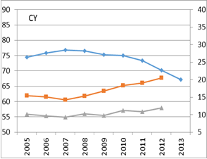
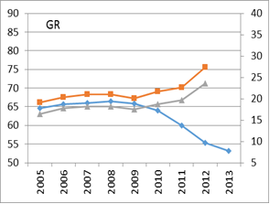
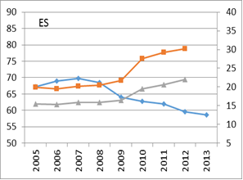
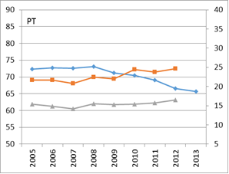
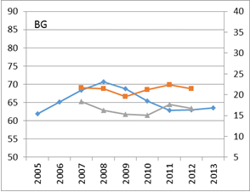
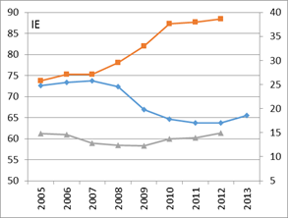
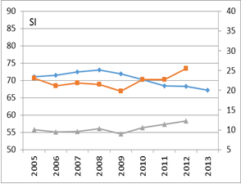
Employment and AROP(a) trends in countries with large continued drop after 2008 (Group A)
preAROP(a)
AROP(a)
Employment rate
Source: Eurostat Statistical Database (employment rate), own calculations based on EU-SILC 2005–2012, most recent 2012-1, published : 2014. 03. 01. (AROP(a), preAROP(a)).
Lesson: AROP(a) and employment rate are mirrored.
preAROP(a) seem to show more direct responses

Slide 10
Group B: Slight drop (with or without recovery) after 2008
Employment rate
AROP(a) trends
Source: Eurostat Statistical Database, and Gabos et al 2015 calculations based on EU-SILC .
Source: EU-SILC 2005–2012, most recent 2012-1, published: 2014. 03. 01.

Slide 11
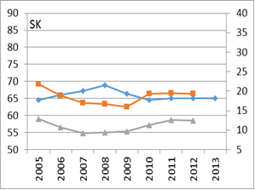
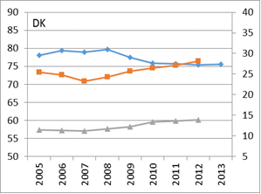
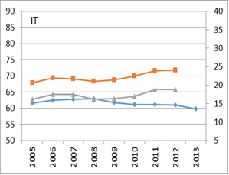
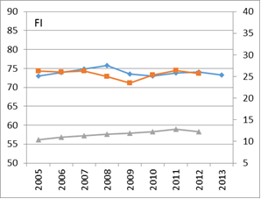
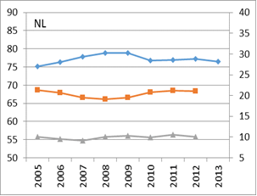
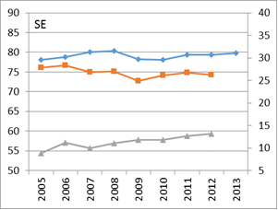
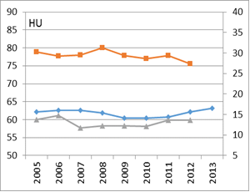
Employment and AROP(a) trends in countries with slight employment drop (with or without recovery) after 2008 (Group B)
preAROP(a)
AROP(a)
Employment rate
Source: Eurostat Statistical Database (employment rate), own calculations based on EU-SILC 2005–2012, most recent 2012-1, published : 2014. 03. 01. (AROP(a), preAROP(a)).
Lesson, roughly: no change on any sides

Slide 12
Group C: Large drop and recovery after 2008
Employment rate
AROP(a) trends
Source: Eurostat Statistical Database, and Gabos et al 2015 calculations based on EU-SILC .
Source: EU-SILC 2005–2012, most recent 2012-1, published: 2014. 03. 01.

Slide 13
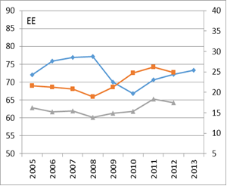
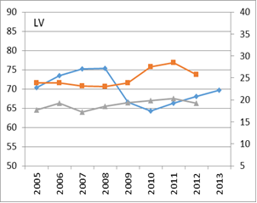
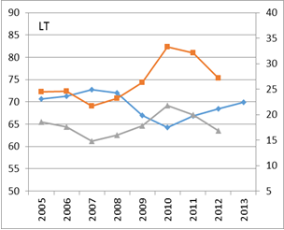
Employment and AROP(a) trends in countries with large employment drop and recovery after 2008 (Group C)
preAROP(a)
AROP(a)
Employment rate
Source: Eurostat Statistical Database (employment rate), own calculations based on EU-SILC 2005–2012, most recent 2012-1, published : 2014. 03. 01. (AROP(a), preAROP(a)).
Lesson: volatile trends, quick reactions,
Employment rate mirrored by preAROP(a)
and AROP(a)

Slide 14
Group D: Longer employment increase periods with no drops
Employment rate
AROP(a) trends
Source: Eurostat Statistical Database, and Gabos et al 2015 calculations based on EU-SILC .
Source: EU-SILC 2005–2012, most recent 2012-1, published: 2014. 03. 01.

Slide 15
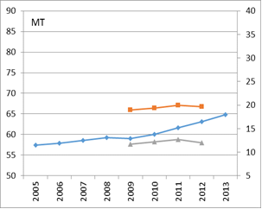
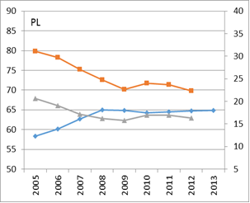
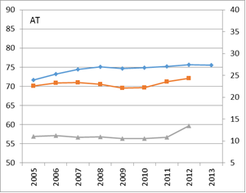
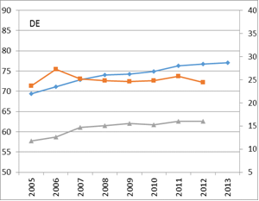
Employment and AROP(a) trends countries with longer employment increase periods with no drops (Group D)
preAROP(a)
AROP(a)
Employment rate
Source: Eurostat Statistical Database (employment rate), own calculations based on EU-SILC 2005–2012, most recent 2012-1, published : 2014. 03. 01. (AROP(a), preAROP(a)).
Lesson: monotonous, mirrored trends

Slide 16
Group E: No substantial change in employment rate throughout the period
Employment rate
AROP(a) trends
Source: Eurostat Statistical Database, and Gabos et al 2015 calculations based on EU-SILC .
Source: EU-SILC 2005–2012, most recent 2012-1, published: 2014. 03. 01.

Slide 17
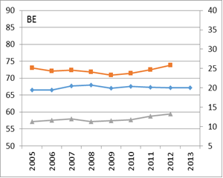
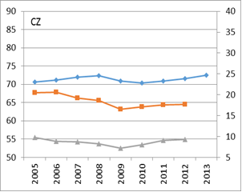
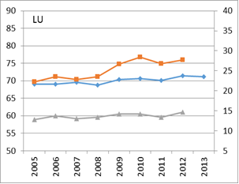
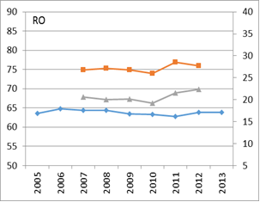
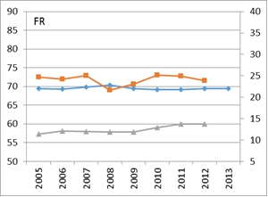
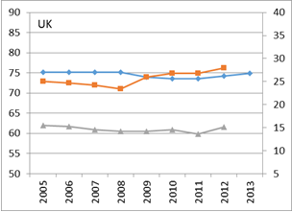
Employment and AROP(a) trends in countries where there was no substantial change in employment rate (Group E)
Source: Eurostat Statistical Database (employment rate), own calculations based on EU-SILC 2005–2012, most recent 2012-1, published : 2014. 03. 01. (AROP(a), preAROP(a)).
preAROP(a) AROP(a) Employment rate
Lesson: no change in Employment rate may be
accompanied b increase or decrease of preAROP(a)
AROP(a) as well

Slide 18
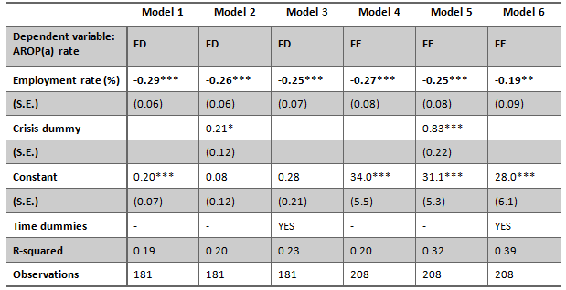
Correlation between employment and poverty change - panel regression analysis
(Model 3) ∆Pov_{it} = α + β∆Emp_{it} + δ_{t} + υ_{it} (Model 6) ∆Pov_{it} = α + β∆Emp_{it} + γ∆Emp_{it-1} + υ_{it} , δ_{t} - time dummies
Notes. Standard errors are shown in brackets. Coefficients are significant at *** p<0.01, ** p<0.05, * p<0.10 levels. Please note that standard errors are cluster standard errors in the case of FD and FE models. R-squared is within R-squared in the FE models.
Lesson: sizeable, negative effect, ∆ 10ppt EMP →
∆ 2.5ppt AROP(a). NB: for PREAROP(a), 5.4ppt!!

Slide 19


Change in Employment rate and AROP(a), 2005-2008, 2008-2012
$∆$, 2005-2008
$∆$, 2008-2012
Source: own calculations based on EU-SILC.
Weak corr before crisis, but higher and clearly negative after
2012/08 - Reduction in ER, but no increase in AROP: BG, LV, (LT), PT

Slide 20


Change in Employment rate and preAROP(a), 2005-2008,2008-2012
$∆$, 2005-2008
$∆$, 2008-2012
Source: own calculations based on EU-SILC.
Higher and more clearly negative correlation in th crisis period
2008/05 – ER growth, but also increase/no change in preAROP: DE, GR, LV, AT
2012/08 – increase in both: LU, decrease in Employment rate but no proortional increase in preAROP: BG, GR, LV, PT

Slide 21
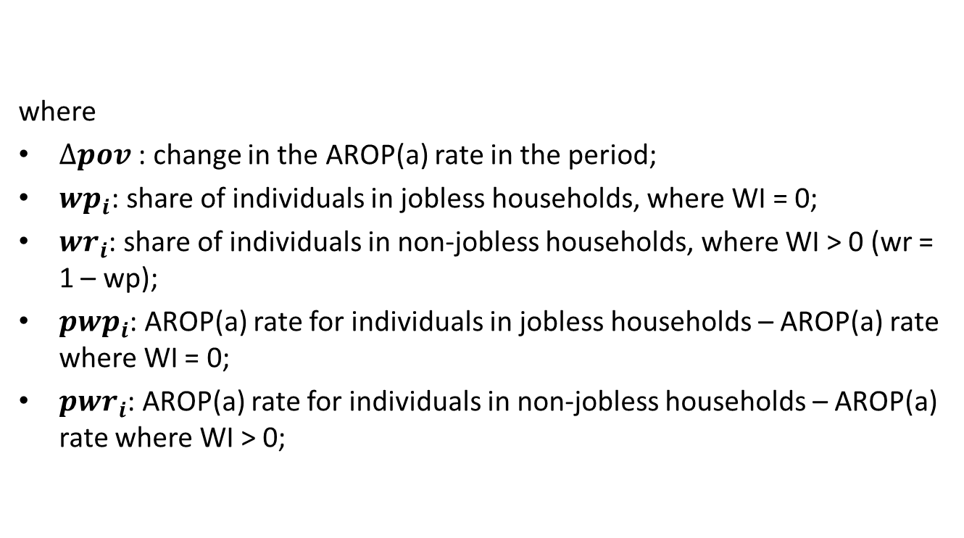
Employment and poverty change – a decomposition analysis (Corluy and Vandenbroucke 2014)
where
$∆pov$: change in the AROP(a) rate in the period;
${wp}_{i}$: share of individuals in jobless households, where WI = 0;
${wr}_{i}$: share of individuals in non-jobless households, where WI > 0 (wr = 1 – wp);
${pwp}_{i}$: AROP(a) rate for individuals in jobless households – AROP(a) rate where WI = 0;
${pwr}_{i}$: AROP(a) rate for individuals in non-jobless households – AROP(a) rate where WI > 0;
$$∆pov= \overline{{wr}_{i}}∆{pwr}_{i}+ \overline{{wp}_{i}}∆{pwp}_{i}+(\overline{{pwp}_{i}}− \overline{{pwr}_{i}})∆{wp}_{i}$$

Slide 22
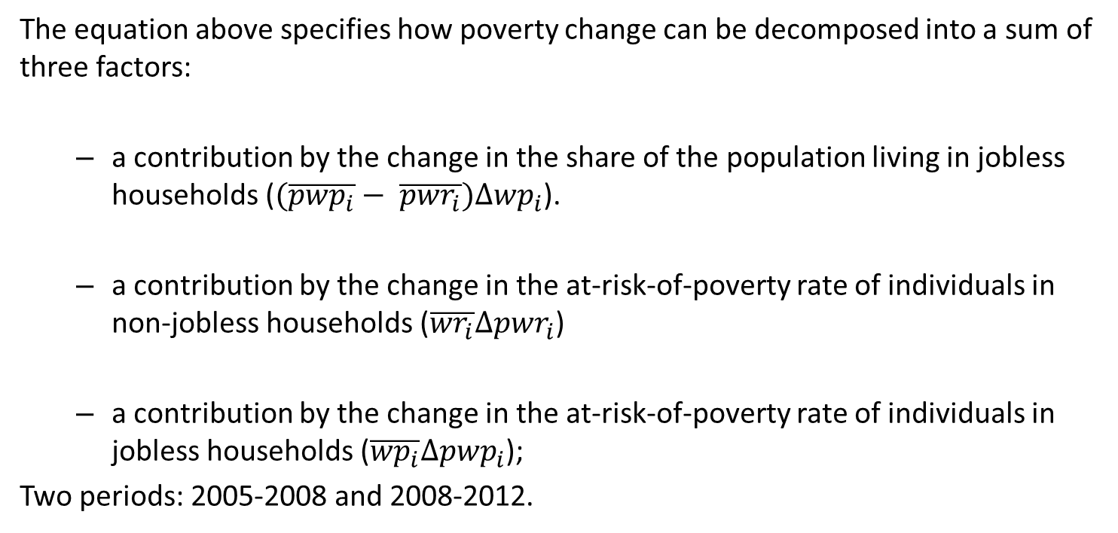
Employment and poverty change – a decomposition analysis (cont’d) (Corluy and Vandenbroucke 2014)
$$∆pov=\left(\overline{{pwp}_{i}}− \overline{{pwr}_{i}}\right)∆{wp}_{i}+\overline{{wr}_{i}}∆{pwr}_{i}+ \overline{{wp}_{i}}∆{pwp}_{i}$$
The equation above specifies how poverty change can be decomposed into a sum of three factors:
  a contribution by the change in the share of the population living in jobless households ($(\overline{{pwp}_{i}}− \overline{{pwr}_{i}})∆{wp}_{i}$).
  a contribution by the change in the at-risk-of-poverty rate of individuals in non-jobless households ($\overline{{wr}_{i}}∆{pwr}_{i}$)
  a contribution by the change in the at-risk-of-poverty rate of individuals in jobless households ($\overline{{wp}_{i}}∆{pwp}_{i}$);
Two periods: 2005-2008 and 2008-2012.

Slide 23
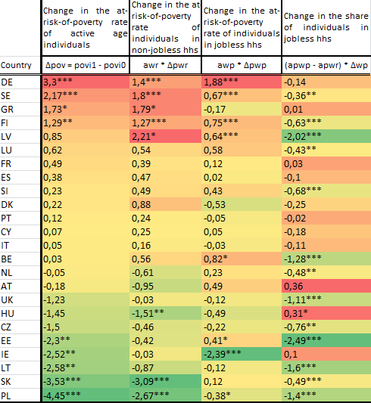
Decomposition of changes in poverty rates, 2005-2008; analysis on jobless (WI=0) and non-jobless (WI >0) households
Decline or no significant change of poverty rate in most of the countries (but DE, SE, GR, FI)
Countries differ in the weights attached to the factors
Decline in the share of persons living in jobless households had a sizeable contribution to poverty rate declines (see the Baltics, UK, PL)

Slide 24
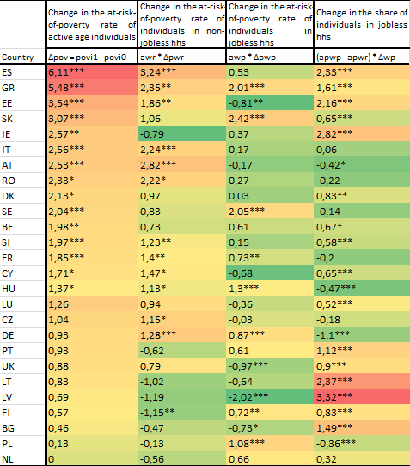
Decomposition of changes in poverty risks, 2008-2012; analysis on WI=0 and WI>0 households
Poverty increased (or did not change) in all countries (no exception)
Countries differ in the weights attached to the factors
The change in share of people living in jobless households contributed to poverty incrase in many countries (Baltics, IE, BG, Southern MSs)
Poverty of jobless also contributed (GR, SK, SE)
Poverty of non jobless (!) also contributed in a number of countries (ES, GR, EE, IT, AT, RO, SI, FR, CY, HU, CZ, DE)

Slide 25
Poverty Reduction Index of social expenditures in the EU Member States, 2005-2012;
PRI = (preAROP(a)-AROP(a))/preAROP(a)*100

Slide 26
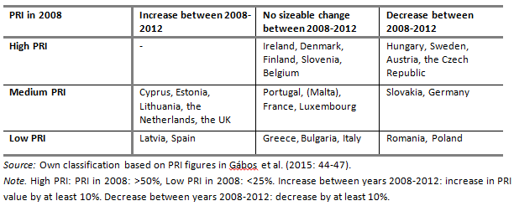
Country classification according to the poverty reduction effects of social transfers between
2008-2012

Slide 27
Summary and conclusions
Employment is important but not the only determinant of poverty
Different employment trajectories across EU countries and heterogeneous trends of poverty under no change in employment regimes
    Negative correlation between individual employment and post-transfer poverty (elasticity around 25%, variations across the sample)
The employment/poverty relationship depends on
    Polarization in the labour markets (which HH WI categories benefit from job growth))
    The level of incomes generated by new jobs
    The poverty reducing effects of active age cash benefits

Slide 28
Summary and conclusions
    Structural effects: declining share of persons in jobless households between 2005 and 2008, contrary to the period 2008-2012; the contributions to the change of poverty rate by the jobless and by the non-jobless households differ across countries
    Social expenditures remain an important tool to fight against poverty, however their effectiveness declined in many of the countries during the crisis: the PRI did not change or decreased in the majority of the countries

Slide 29
Summary and conclusions
The success of poverty reduction depends to a large extent on three factors:
  the dynamics of overall employment growth
  the fair distribution of employment growth across households with different work intensity
  and properly designed social welfare systems to smooth out the income losses of those families who are, for some reasons, unable to generate sufficient income for themselves from the labour market

Slide 30

Thank you!
ImPRovE project: www.improve-research.eu
Tarki: www.tarki.hu
Author: toth@tarki.hu

Slide 31
Appendices
P.s: on …2013-2014 …

Slide 32
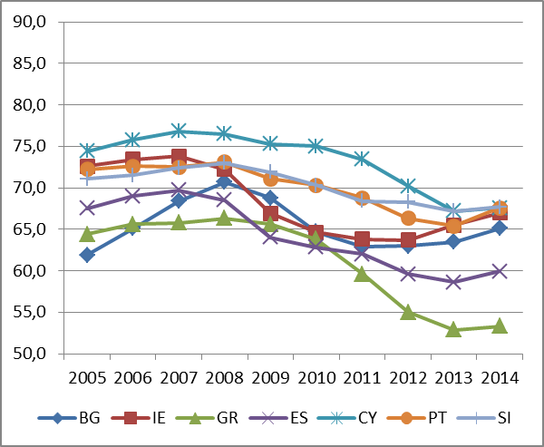
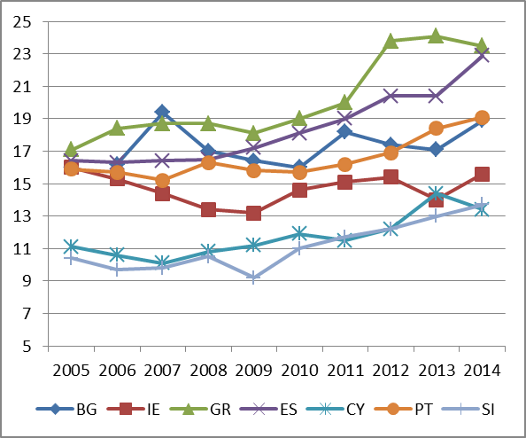
Group A: latest employment and AROP(a) trends
Employment rate (20-64 yrs)
AROP(a) trends (18-64 yrs)
Source: Eurostat Statistical Database, last update: 26.01.2016.
Source: Eurostat Statistical Database, last update: 26.01.2016.

Slide 33
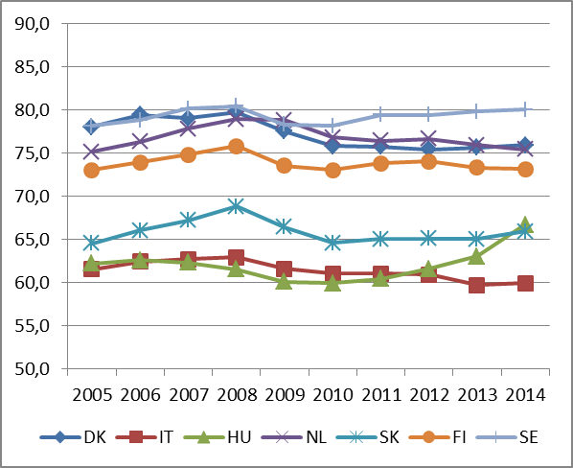
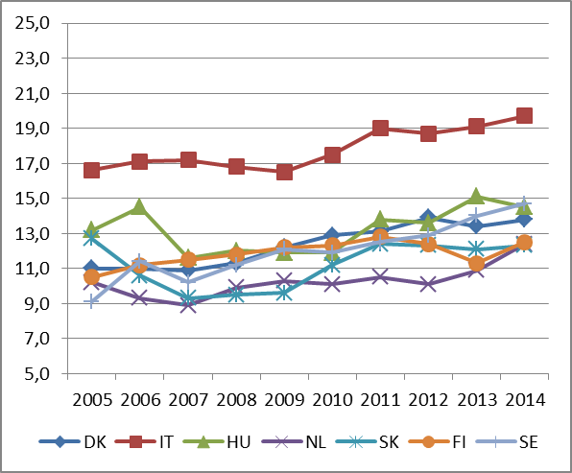
Group B: latest employment and AROP(a) trends
Employment rate (20-64 yrs)
AROP(a) trends (18-64 yrs)
Source: Eurostat Statistical Database, last update: 26.01.2016.
Source: Eurostat Statistical Database, last update: 26.01.2016.

Slide 34
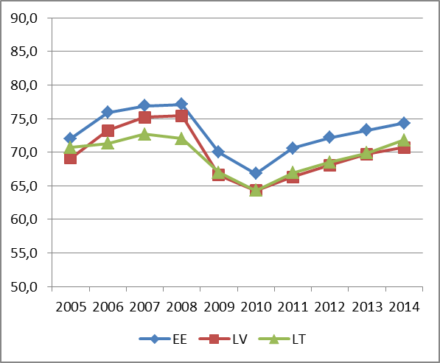
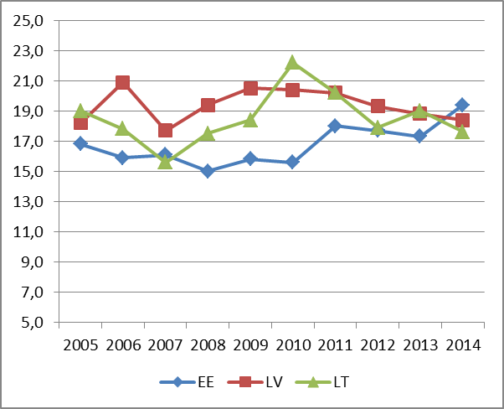
Group C: latest employment and AROP(a) trends
Employment rate (20-64 yrs)
AROP(a) trends (18-64 yrs)
Source: Eurostat Statistical Database, last update: 26.01.2016.
Source: Eurostat Statistical Database, last update: 26.01.2016.

Slide 35
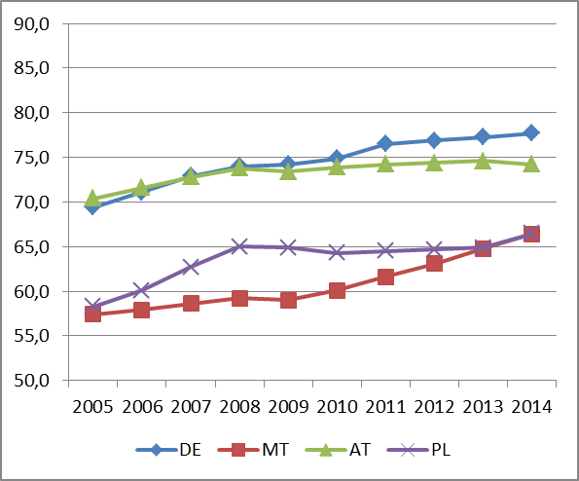
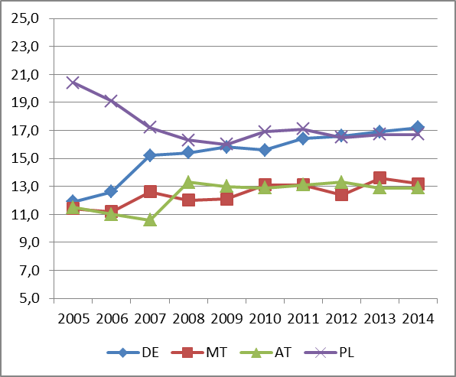
Group D: latest employment and AROP(a) trends
Employment rate (20-64 yrs)
AROP(a) trends (18-64 yrs)
Source: Eurostat Statistical Database, last update: 26.01.2016.
Source: Eurostat Statistical Database, last update: 26.01.2016.

Slide 36
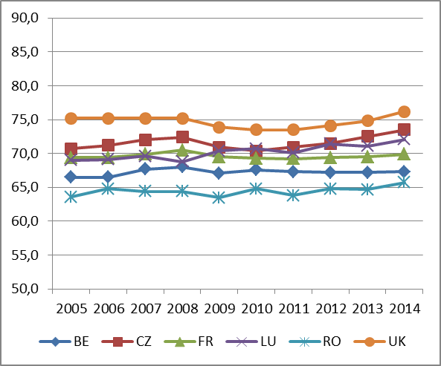
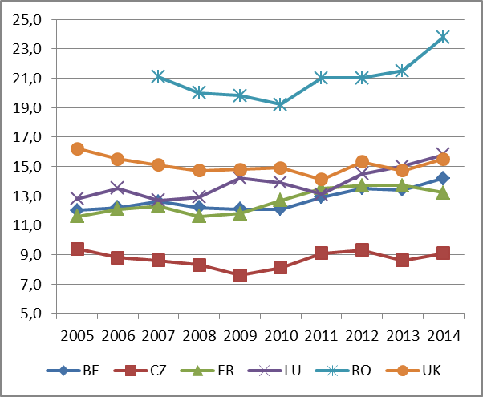
Group E: latest employment and AROP(a) trends
Employment rate (20-64 yrs)
AROP(a) trends (18-64 yrs)
Source: Eurostat Statistical Database, last update: 26.01.2016.
Source: Eurostat Statistical Database, last update: 26.01.2016.

