Slide 1
Prospects of SSH research: impacts, cooperation, interdisciplinarity and links to policies
Lídia Puigvert
University of Barcelona

Slide 2
Notes:
Last year Nature published that Europe must fund social sciences.
The argument was that SSH research is already having important social impacts, that is, it is leading to important social improvements

Slide 3
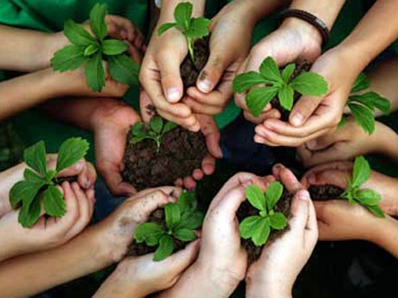
We must distinguish between:
Scientific impact
Dissemination
Transference
Social impact

Slide 4
Scientific impact takes place within academia, when researchers (peers) read, cite and use our research results for their future research
Many metrics measure this impact (from impact factor to altmetrics)

Slide 5
Dissemination takes place when institutions, companies, NGOs, and citizens at large get to know about our research results (often through media or outreach activities)

Slide 6
Transference takes place when policy-makers, companies, NGOs, or citizens use our research results to plan and carry out their interventions

Slide 7
Social impact takes place when the transference of research results leads to actual social improvements (experienced by individuals and societies, according to societal objectives)

Slide 8
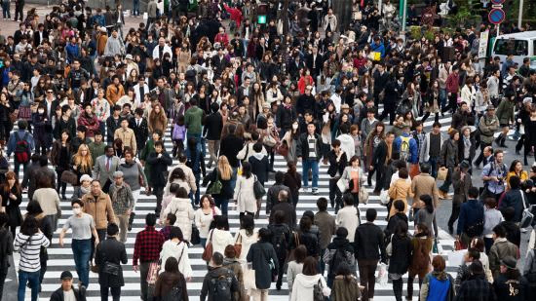
SSH research had and have relevance social impact.
SSH research has great potential and capacity to improve European societies
Notes:
Europe misses a great potential of highly qualified researchers and very important research by missing to support SSH research.

Slide 9
Two examples:
Notes:
Europe misses a great potential of highly qualified researchers and very important research by missing to support SSH research.

Slide 10
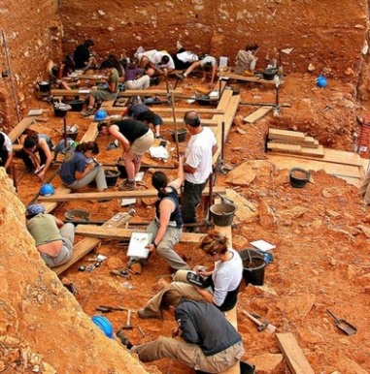
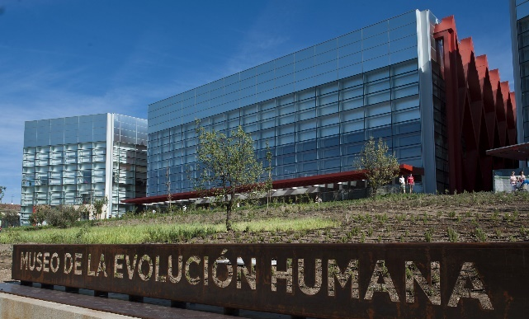
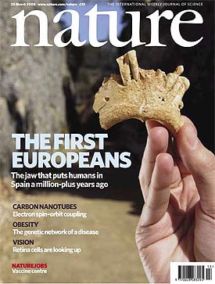
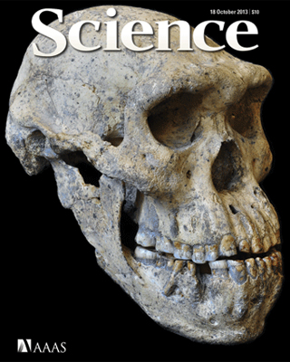
Example 1: The Atapuerca Project (paleontology)
Museum of Human Evolution (2010):
500.000 visitors
More than 1130 new jobs
Economic impact: 53 million €

Slide 11
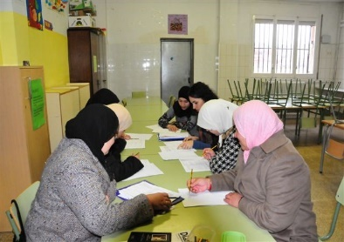
Example 2: INCLUD-ED Project (social inclusion, FP6)
Increase in school performance and employment in deprived areas:
Increase in 68% in reading skills
Decrease absenteeism from 30% to 1%
Increase employment in 39%

Slide 12
1. Solar Energy
2. Coronary Heart disease
3. Planes
4. Alzheimer
5. Electric car
6. Micro-chip
7. Alpha mannosidosis disease
8. Architecture
9. Clinical partnership
10. Includ-ed (SSH)
Notes:
Includ-Ed was the only research in SSH selected by the European Commission among the 10 Success Stories.
Why? Because of the added value for Europe in terms of political and social impact.

Slide 13
How do we gather and evaluate social impact?
Non-profit initiative launched by the IMPACT-EV consortium (FP7, European Commission) http://www.ub.edu/sior/
Open source repository to store evidence of social impact
SIOR responds to the open demand of measurable parameters of social improvements generated by scientific projects, thus promoting a necessary alternative to the stagnation of scientific results and enabling real social impact.

Slide 14
How do we gather and evaluate social impact?
Any researcher or research group worldwide can freely upload evidence of their research social impact through registering to SIOR with an ORCID id
Any institution or citizen around the world can freely see the evidences of the studies, researchers and research groups with social impact

Slide 15
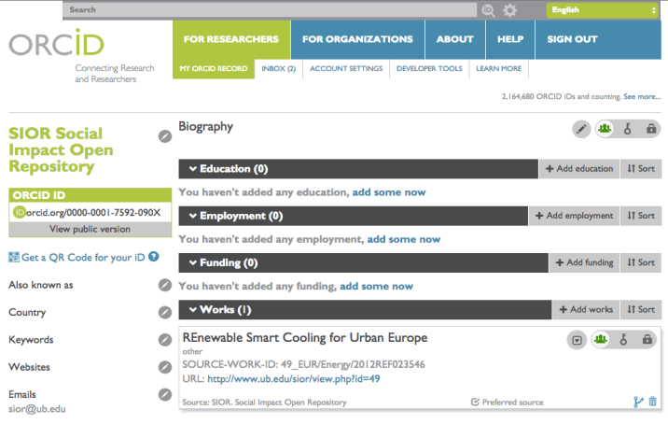
How do we gather and evaluate social impact?
Collaboration to link the social impact of the research published in Nature
Social Impact Open Repository
Link between social impacts of researchers to their individual profiles

Slide 16
How do we gather and evaluate social impact?
SIOR provides scores (through peer review process) according to concrete social impact criteria:
http://www.ub.edu/sior/

Slide 17
How do we gather and evaluate social impact?
SIOR provides scores (through peer review process) according to concrete social impact criteria:
Connection to UN Sustainable development Goals, EU2020 targets or other similar official targets
Percentage of improvement achieved in relation to the starting situation
Transferability of the impact, the actions developed based on the project’s findings have been transferred to other contexts besides the original one
Publication in scientific journals (with a recognized impact), or in governmental or non-governmental official reports
Sustainability, the impact achieved by the action developed based on the project’s findings has showed to be sustainable throughout time

Slide 18
Includ-Ed

Slide 19
There are many scientific contributions that enable social impact in the future
Research Enabling Social Impact (RESI) is the cumulative impact of the many research that has contributed to further research which in turn has achieved social impact.
In order to find a solution there are many research projects and teams exploring different avenues. They have all been necessary to find the solution, facing both failures and successes on the way

Slide 20
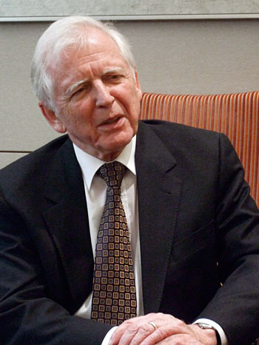
Example in cancer research:
Social Impact of Research: combating cancer disease
Research Enabling Social Impact: research about the possible connection between infection agents and human cancer.
“In the late 1960s Herpes simplex type 2 (HSV-2) emerged as the prime suspect based on some seroepidemiological observations. I had asked my colleague Heinrich Schulte-Holthausen to use the same technique to search for HSV-2 sequences in cervical cancer biopsies. All attempts, however, failed.”
Later “Up to 20% of sera from human adults also revealed neutralising antibodies to this virus. Our attempts to isolate a human correlate, however, failed.”
“I have devoted my scientific life to the question to what extent infectious agents contribute to human cancer, trusting that this will contribute to novel modes of cancer prevention, diagnosis and hopefully later on also to cancer therapy. I am of course pleased to see that at least part of this programme has been successful.”
Harald zur Hausen
Nobel Prize in Medicine 2008

Slide 21
Atapuerca project:
Social Impact of Research: 1) creation of employment and economic growth in the region and 2) creating intangible cultural happiness.
Research Enabling Social Impact: Groups of paleontologists working in Atapuerca Mountains since 1863
1863: the first discoveries of fossils were found.
1976: first human remain is found
1997: discovery of a new human species: homo antecessor
More than a century of research has been developed in Atapuerca, which eventually enabled the discovery of homo antecessor, as one of the earliest known human species in Europe
Atapuerca Project

Slide 22
We cannot change the past, but we can change the present and the future and, by demonstrating social and political impact, SSH research is already contributing to do so

Slide 23
Thank you!
contact: crea@ub.edu

