Slide 1
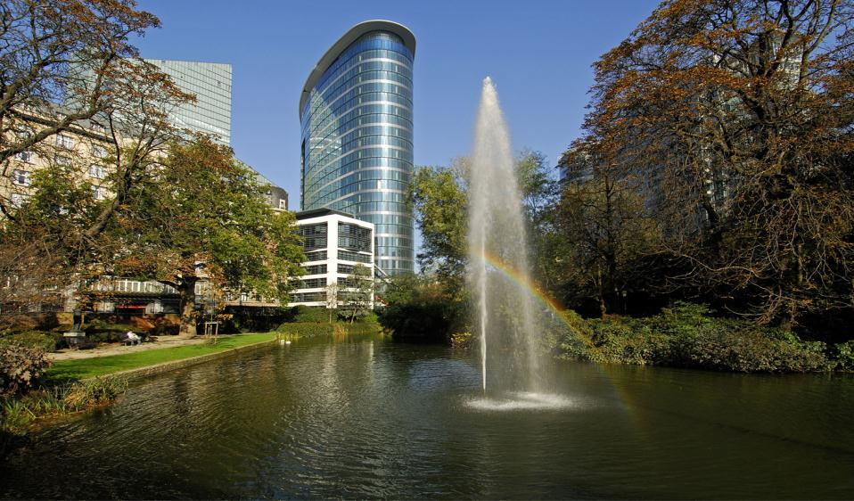
The European Research Council
Young scientists and future career
opportunities
for ERC grantees
Angela Liberatore
Head of Unit Social Sciences and Humanities
ERCEA
© Art & Build Architect / Montois Partners / credits: S. Brison

Slide 2
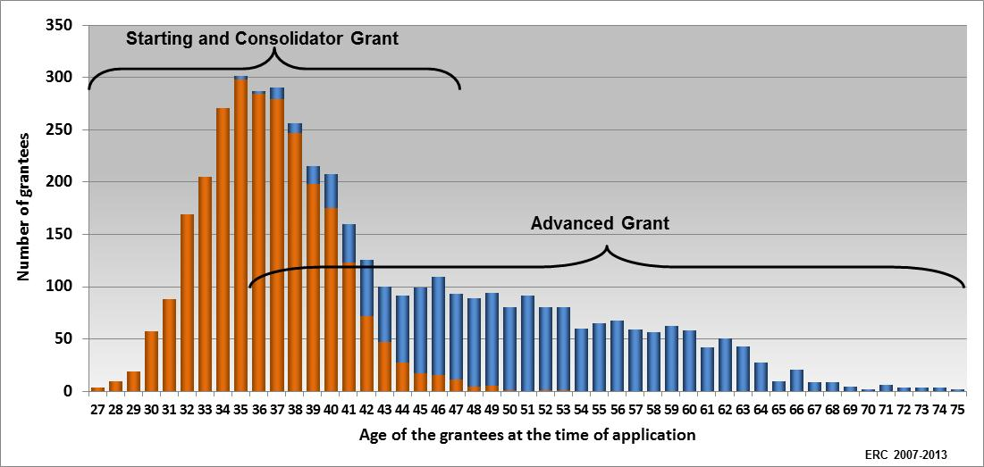
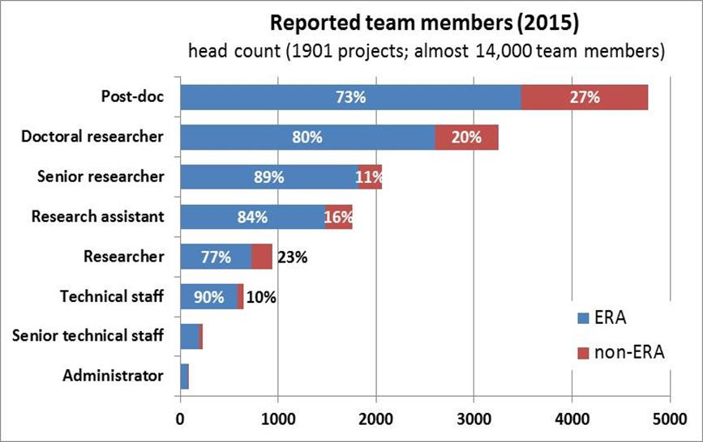
ERC: Priority to Young Scientists
+ 22 000 PhD and post-doc researchers working in ERC teams.
Two-thirds of ERC grants to early-stage Principal Investigators.

Slide 3
Researchers career development
and complementary funding schemes
ERC Advanced
PoC
PoC
ERC StG – Consolidators
Senior
Professor
ERC StG - Starters
PoC
Full Professor
Marie Skłodowska Curie
Junior Professor/
Junior Researcher
Associated Professor
Erasmus
Post-docs
Post
Graduates
Students

Slide 4
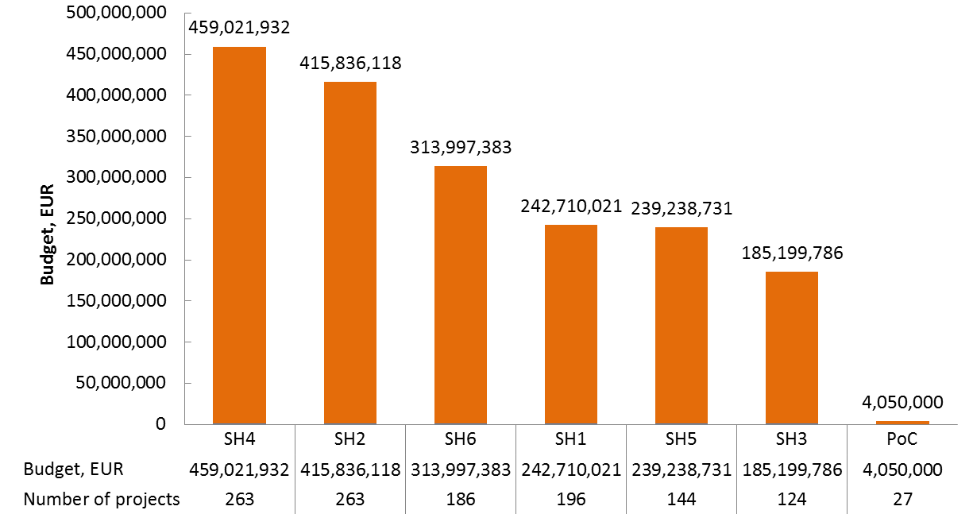
Number and budget of ERC funded projects in SH domain under FP7 and H2020 (2007- 2015)

Slide 5
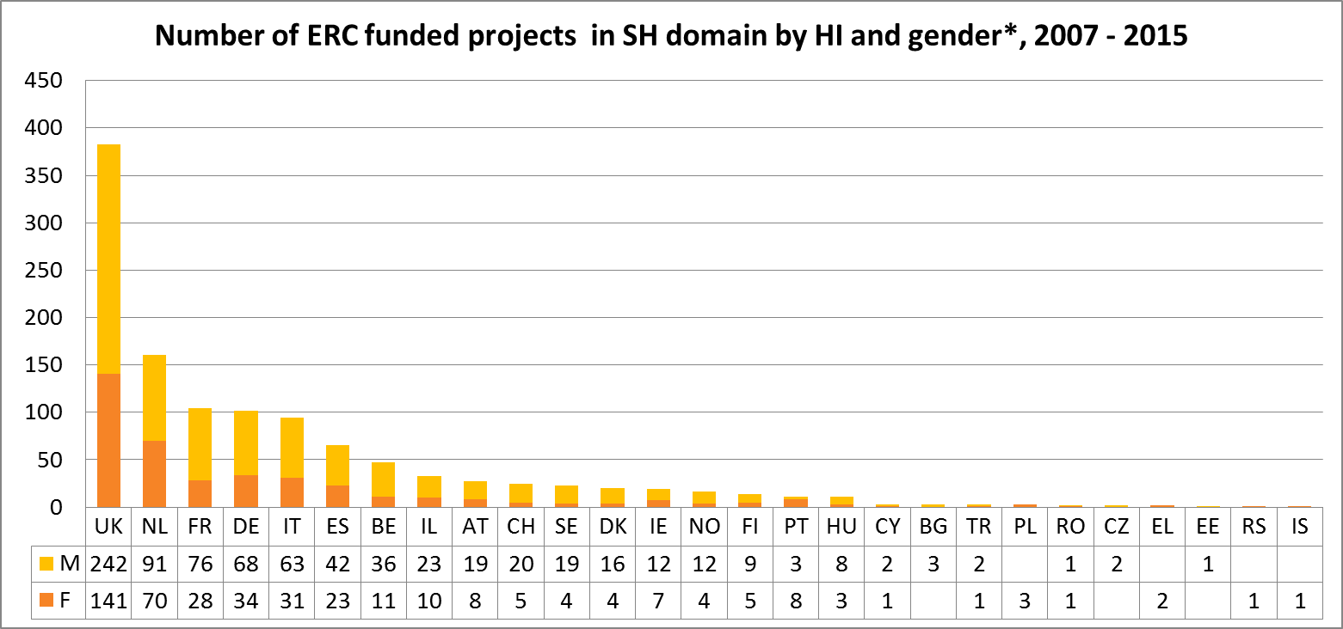
Number of ERC funded projects in SH domain by HI country and gender, 2007 - 2015
* PoC projects not included

