Slide 1
Spatial Patterns in the Intra-European Migration Before and after Eastern Enlargement: winners and losers
Vladimír Baláž, Martina Chrančoková and Katarína Karasová
Institute for Forecasting, Slovak Academy of Sciences

Slide 2
Intra-European migration: big canvas
There is more about migration than jobs and wages
The traditional models of international migration originate in the human capital theory and focus on decisions by individual migrants (Sjaastad 1962, Harris and Todaro 1970, Borjas 1987, or decisions by the migrant households (Mincer 1978, Borjas 1999). The cost/benefit approach failed to explain:
why the total volume of international migration flows remains rather low in World, where vast income differences persist over decades, and
why many migrants prefer countries with medium income levels over high-income countries.
Theories based on the economic cost/benefit analysis work best for migration from poor to rich countries, but are unable to explain many distinctive types of migration between European countries, such as life-style migration or migration by tertiary students. Intra-European migration accounts for a much more diverse set of migration motives than job and income disparities.
The geographical distribution of the migrant stocks only partially was responsive to income opportunities. Jobs and educational opportunities were major motives for the intra-European migration of V4 nationals (Kahanec 2012). Many of the migrants, for example, have migrated to the United Kingdom not only in order to earn money but also to try life abroad, see the world, or learn English (Parutis 2014).
Migration between high-income countries and middle high-income may reflect more varied tastes and lifestyle choices, such as education (King and Raghuram 2013), novelty seeking, personal relationship, culture preferences, climate considerations and many more. The same pair of European countries may therefore generate quite diverse forms migrant exchange. Flow of the Portuguese labour migrants pursuing higher wages and students enrolling on British Universities, for example, meets flow of the UK retirees seeking sunny climate and lower living costs in Portugal

Slide 3
Average annual intra-European migrant stocks
(million persons and per cent of total)
Flow type | 1997-2004 | 2005-2013 | Growth rates: 2005-2013 to 1997-2004
Total stocks: | 9.04 mil. | 13.74 mil. | 1.52
Stocks by position within the migration system
centre to centre | 5.57 (61.5%) | 6.64 (48.4%) | 1.19
centre to periphery | 0.13 (1.5%) | 0.22 (1.6%) | 1.68
periphery to centre | 3.12 (34.4%) | 6.52 (47.5%) | 2.09
periphery to periphery | 0.24 (2.7%) | 0.35 (2.6%) | 1.44
Stocks by region of origin:
Middle Europe | 2.55 (28.2%) | 3.33 (24.2%) | 1.30
Eastern Europe | 1.82 (20.1%) | 5.23 (38.0%) | 2.87
Northern Europe | 1.12 (12.3%) | 1.53 (11.1%) | 1.37
Southern Europe | 3.57 (39.6%) | 3.65 (26.6%) | 1.02
Stocks by geographical and language proximity
neighbour countries | 3.64 (40.2%) | 4.38 (31.9%) | 1.20
language proximity, narrow (same language) | 1.96 (21.6%) | 2.21 (16.1%) | 1.13
language proximity, broad (same language family) | 4.88 (53.8%) | 6.94 (50.5%) | 1.42
Notes: Periphery is defined as CZ, HU, PL, SK, SI, HR, LT, LV, EE, BG, RO, PT, EL, CY, MY and IS. All other countries are considered centre countries. East is defined as CZ, HU, PL, SK, SI, LT, EE, LV, RO and BG. South is defined as ES, IT, PT, EL and CY. North is defined as UK, IS, DK, NO, SE, and FI. Middle is defined as DE, FR, BE, NL, LU, CH and AT. Countries separated by sea distance were considered neighbours if connected via bridge (DK-SE) or tunnel (UK-FR) or when sea distance was shorter than 100 km. Language proximity (narrow) was established for countries, where at least 10 % of population spoke the same language. The broad concept applies to pair of the origin-host countries where at least 10 % of population spoke the language from the same language family.

Slide 4
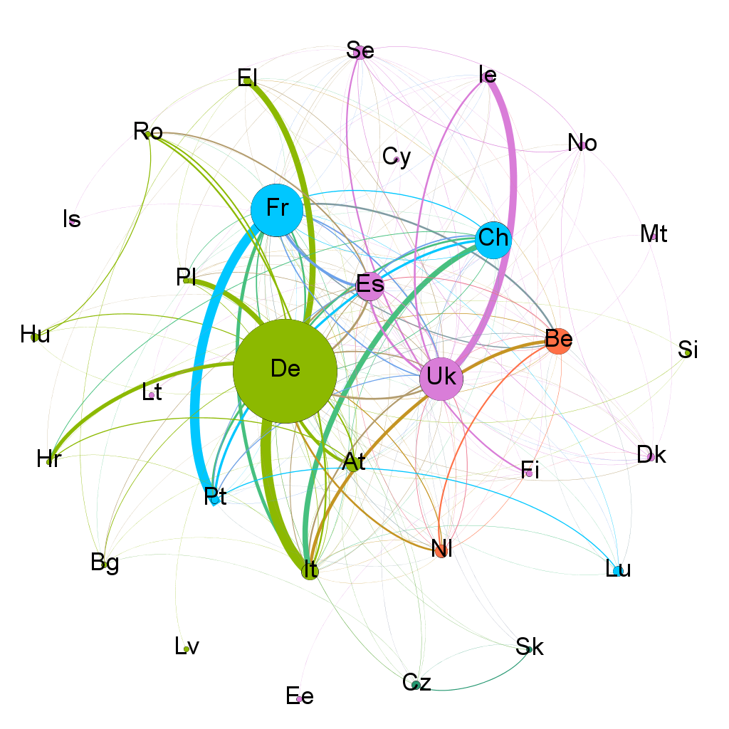
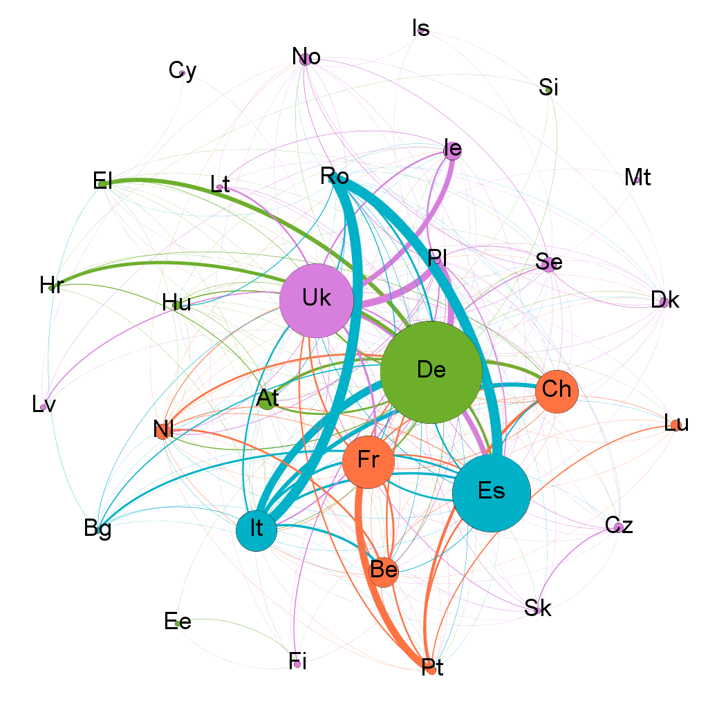
Network diagram for intra-European migrant stocks
(1997-2004 versus 2005-2013 averages, stocks over 4000 migrants)
1997-2004
2005-2013
The network diagram maps matrix of inflows and outflows from the 31 European countries.
There are distinctive patterns of core and peripheries, where the core is formed by the UK, Germany, France, Switzerland, Italy and Spain in 1997-2013. Secondly, there are also strong periphery-core flows within the modules, and many these flows seem to be based on language proximity, geographical proximity and/or economic connectivity (AT-DE, CH-DE, BE-FR, FR-CH, IE-UK):

Slide 5
Determinants of the spatial patterns in the intra-European migration
Correlation and factor analysis
Spatial patterns of the intra-European migration network are modelled via function as mst_{fh} = f(EV)
where mst_{fh} is the share of emigrants from country h residing in country f, and EV is a vector of explanatory variables. . The five major destinations for each country accounted for some 80%, and in some cases, for 90%, of total outflows.
 | 1997-2004 |  | 2005-2013
 | Pearson | Sig. | Pearson | Sig.
Economic push-pull variables (Eurostat)
1. GDP (PPS) levels | -0.025 | 0.761 | 0.004 | 0.961
2. Average wage (single. no children) | -0.020 | 0.823 | -0.031 | 0.705
3. Average wage (married. two children) | -0.028 | 0.744 | -0.037 | 0.651
4. Social benefits | -0.106 | 0.206 | 0.054 | 0.501
5. Unemployment rate total | -0.120 | 0.138 | -0.027 | 0.737
6. Unemployment rate (up to age 25) | 0.002 | 0.976 | 0.031 | 0.701
7. Long-term unemployment rate | -0.134 | 0.097 | -0.047 | 0.563
Non-monetary costs and benefits (E Social Survey)
8. Life satisfaction | 0.033 | 0.687 | -0.038 | 0.637
9. Satisfaction with current econ. performance | 0.147 | 0.067 | -0.128 | 0.113
10. Opinions on the state of democracy | 0.036 | 0.659 | -0.117 | 0.148
11. Satisfaction with quality of education | 0.106 | 0.188 | -0.018 | 0.825
12. Self-reported levels of personal happiness | -0.004 | 0.960 | -0.015 | 0.852
13. Self-reported levels of personal trust | 0.005 | 0.949 | 0.007 | 0.926
Connectivity variables (Eurostat, OECD)
14. Merchandise imports shares | 0.643 | 0.000 | 0.456 | 0.000
15. Merchandise exports shares | 0.625 | 0.000 | 0.456 | 0.000
16. Foreign ownership of domestic patents | 0.475 | 0.000 | 0.258 | 0.001
17. Domestic ownership of foreign patents | 0.381 | 0.000 | 0.323 | 0.000
18. Patents with foreign co-inventor(s) | 0.476 | 0.000 | 0.366 | 0.000
19. Nights spent by foreign tourists | 0.664 | 0.000 | 0.540 | 0.000
20. Language known | 0.291 | 0.000 | 0.338 | 0.000
21. Language useful | 0.217 | 0.007 | 0.295 | 0.000
22. Driving distance between capitals | -0.155 | 0.054 | -0.105 | 0.192
Factor 1 ‘Connectivity’
Factor 2 ‘Languages’

Slide 6
Factors of the spatial patterns in the intra-European migration
Regression analysis
 | 1997-2004 |  |  | 2005-2013
 | B | t | Sig | B | t | Sig
Constant |  | 15.338 | 0.000 |  | 14.456 | 0.000
F1 Connectivity | 0.669 | 10.651 | 0.000 | 0.476 | 6.748 | 0.000
F2 Languages | 0.207 | 3.292 | 0.001 | 0.305 | 4.334 | 0.000
Adjusted R² | 0.491*** |  |  | 0.319***
The Factor 1 on connectivity had the highest B (standardised) values in both time periods and remained the strongest predictor of the intra-European migrant stocks. The relative importance of Factor 1, however, decreased over time. The decrease probably is related both to territorial re-orientation of intra-Europeans flows in tourism, trade and knowledge (independent variables), and to the re-orientation of migrant flows (dependent variables). The decrease in relative importance of Factor 1 also refers to increased diversity in the intra-European migration after 2004.
The Factor 2 on languages increased in importance over time. It indicates that while many high-intensity migration flows developed between countries speaking with different languages (e.g. Romania to Italy and Spain), there also was an increase in flows related to language similarity (e.g. Germany to Switzerland and Austria). The Factor 2 also embodies growing importance of English as global language (‘language known’ and ‘language useful’).

Slide 7
The European migration system
stable, but not static
The network analysis, and the factor and regression analysis support idea of the intra-European migration system. The migration system is a product of interacting nation-states and corresponding socio-cultural, geopolitical, and economic factors and policies (Zlotnik 1999, DeWaard et al 2012). The system is an identifiable geographical structure that persists across space and time.
Stability of the network does not mean the network of the intra-European migrants is static; on the contrary it accounts for dynamic relationships between countries of origin and destination. The geographiucal d and (broad) language-proximity, for example, significantly informed memberships in individual modules.
The dynamic nature of the intra-European migration networks is demonstrated by emergence of new sets of institutions shaping migration flows (visa-free travel, opening labour markets, student mobility programmes, and introduction of the new transport modes). The UK-centred migrant inflows from Poland and other Eastern EU Members, for example, are not informed by the traditional neighbour / language proximity framework, but by rising importance of English as global language, and availability of the low-cost travel (Jenissen 2007).

Slide 8
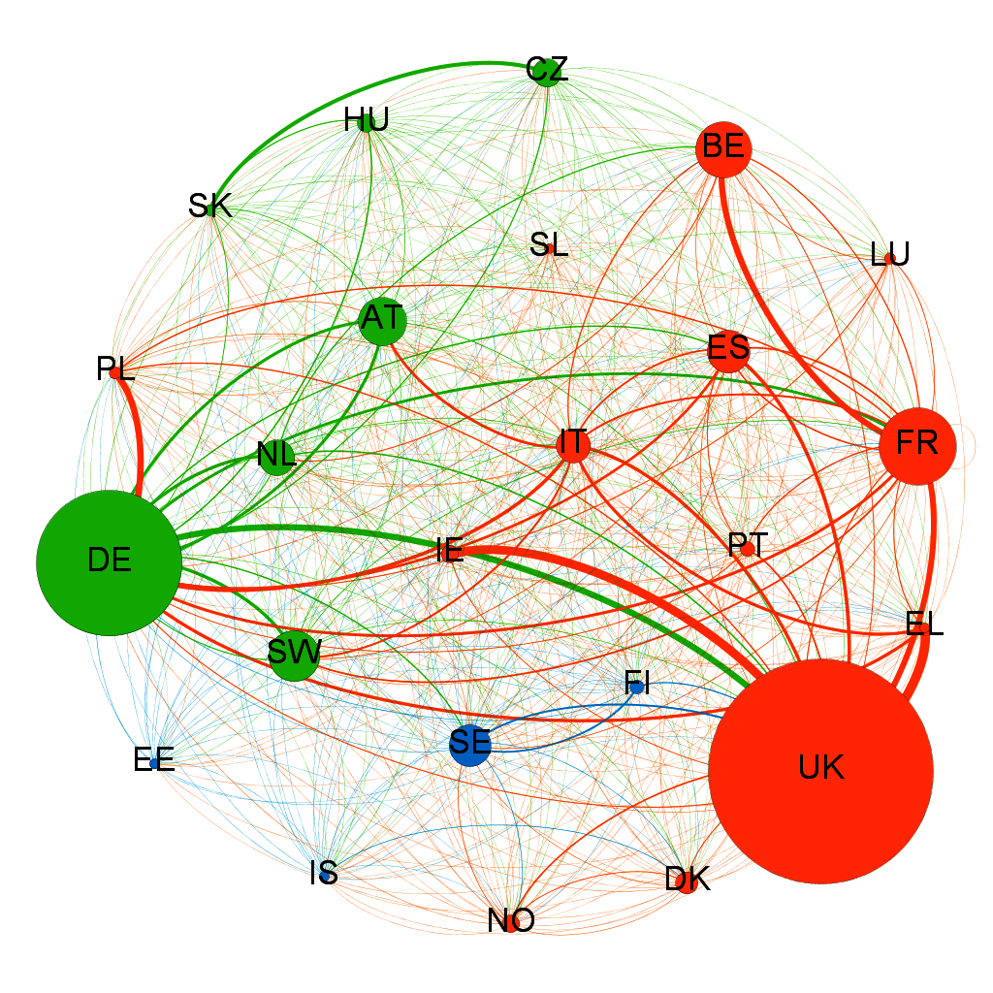
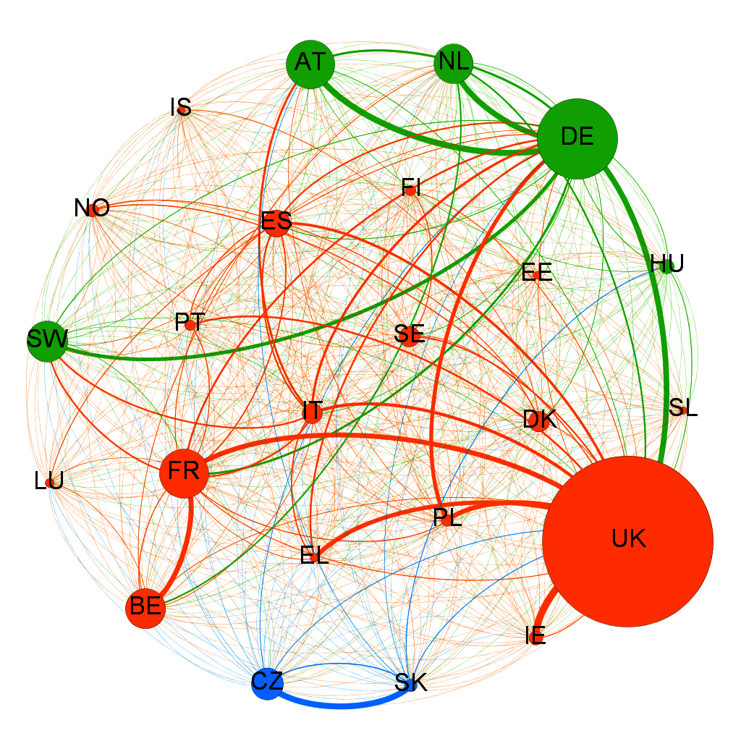
Migration of tertiary students
(`2002-2007 versus 2008-2012 averages, all stocks)
2002-2007
2008-2012
The spatial distribution of the intra-EU student migration is highly polarised in three main communities (UK, French, German). The UK emerged as the major winner in the quest to build up international student stocks. France and Germany, on the other hand, built increasingly denser ties with their immediate neighbours.
Again connectivities were more important than traditional push pull factors. Both income gaps and non-economic variables, describing satisfaction with private life and public institutions were insignificantly correlated with student migration. Instead, investment in higher education and excellence in teaching and research were the most important push-pull ‘gap’ variables.

Slide 9
Migration of tertiary students
(`1998-2002, 2003-2007 and 2008-2012)
Type | Annual average stocks (millions of students) |  |  | Growth rates: 2008- 2012 to 1998-2002
 | 1998-2002 | 2003-2007 | 2008-2012
Total stocks, of which | 0.335 | 0.385 | 0.495 | 1.48
centre – centre | 0.044 | 0.045 | 0.054 | 1.22
centre – periphery | 0.052 | 0.066 | 0.106 | 2.06
periphery – centre | 0.158 | 0.175 | 0.200 | 1.27
periphery–periphery | 0.081 | 0.099 | 0.135 | 1.67
Neighbour country stocks | 0.148 | 0.187 | 0.271 | 1.83
Language proximity stocks | 0.129 | 0.156 | 0.230 | 1.78
Notes: The centre is defined as France, Germany and the UK, based on their relative importance as destinations. Countries separated by sea distance were considered neighbours if connected via bridge (DK-SE) or tunnel (UK-FR) or when sea distance was shorter than 100 km. Language proximity was established for countries, where at least 10 % of population spoke the language from the same language family (Germanic, Romance and Slavic). Some neighbour and language proximity stocks fall in both categories.
There are distinctive patterns of core and peripheries, where the core is formed by the UK, Germany and France. Secondly, there are also strong periphery-core migrations evident within the modules, and many of these seem to be based on language and/culture proximity (AT-DE, SW-DE, BE-FR, IE-UK).
There was a general strengthening of the UK as a destination across the total time period. Interestingly, the most distinctive periphery to periphery migration was between Slovakia and the Czech Republic in 2008-2012, a pair of countries with strong spatial and language proximity

Slide 10
The European migration system
Winners and losers?
Labour force in age group 20-64 (million and %)
Country | 2013 | 2060 | Difference 2060-2013 | loss 2060 – 2013 (%)
UK | 30.3 | 35.1 | 4.8 | 15.8
France | 29.1 | 31.6 | 2.5 | 8.6
Austria | 4.1 | 4.1 | 0.0 | 0.0
Italy | 24.0 | 24.0 | 0.0 | 0.0
Spain | 22.8 | 20.3 | -2.6 | -11.4
Czech Republic | 5.2 | 4.6 | -0.6 | -11.5
Hungary | 4.3 | 3.7 | -0.6 | -14.0
Germany | 40.6 | 30.0 | -10.6 | -26.1
Greece | 4.8 | 3.5 | -1.3 | -27.1
Romania | 8.6 | 6.0 | -2.6 | -30.2
Poland | 18.1 | 12.5 | -5.6 | -30.9
Portugal | 4.9 | 3.3 | -1.6 | -32.7
Slovakia | 2.7 | 1.7 | -1.0 | -37.0
Latvia | 1.0 | 0.6 | -0.4 | -40.0
Lithuania | 1.4 | 0.7 | -0.7 | -50.0
The Europe is undergoing an unprecedented demographic transition. The transition, however, is unequal among the EU Members. Some countries are impacted by population ageing. Numbers of available workforce are determined by (1) birth rates, and (2) net immigration rate.
So far the new Member Countries seem major losers of the transition. They cope both with low rates and significant loss of human capital.
Potential solutions
Increasing immigration from third countries (needs to deal with xenophobia and improvements in immigration policies)
Increasing employment opportunities and wages in high-tech industries

Slide 11
The European migration system
Solutions for losers?
Potential solutions for Slovakia
Slowing down emigration
Increasing immigration from third countries (needs to deal with xenophobia and improvements in immigration policies)
Increasing employment opportunities and wages in high-tech industries

Slide 12
Emigration from Slovakia
Unemployment rates and emigration flows & destinations
Emigration was a vent on labour market in 1990s and 2000s
Unemployment rates decreased, but emigration has not slowed down in 2010s.
Why? Wages, career opportunities......

Slide 13
Emigration from Slovakia
Working immigrants in Slovakia
Some 27,000 foreigners working in Slovakia in 2016: 50% the EU national and 50% third country nationals (Ukraine, Serbia).
Most foreigners were manual workers and technicians in manufacturing industries.

Slide 14
Emigration from Slovakia
Wages and brain drain
The average wages have been increasing rapidly, bur remain too low to prevent brain drain.
About one quarter of the Slovak tertiary full-time students study abroad. As much as one half of them may never return.
Homework to do: improve quality of education, build knowledge-intensive industries, increase wages, stop emigration!

Slide 15
Thank you!

